Slide 1
Difference Between Policy, SOP, & Guideline
Policy:
Formal and high level requirement for securing the organization and its IT assets (mandatory)

Slide 2
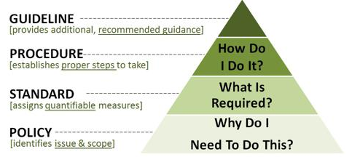
Difference Between Policy, SOP, & Guideline
https://www.linkedin.com/pulse/20140611162901-223517409-difference-between-guideline-procedure-standard-and-policy

Slide 3
Difference Between Policy, SOP, & Guideline
Policy:
Scope is across organization so should be brief and focusing on desired results
Signed off by senior management

Slide 4
Difference Between Policy, SOP, & Guideline
Procedure / SOP:
More detailed description of the process; who does what, when, and how
Scope is predominantly at a department level having specified audience
May be signed off by departmental head
https://www.slu.edu/its/policies

Slide 5
Difference Between Policy, SOP, & Guideline
Guideline:
General recommendation or statement of best practice
Not mandatory
Further elaborates the related SOP
https://www.slu.edu/its/policies

Slide 6
Difference Between Policy, SOP, & Guideline
Standard:
Specific and mandatory action or rule
Must include one or more specifications for an IT asset or behavior
Yardstick to help achieve the policy goals
https://www.slu.edu/its/policies

Slide 7
Difference Between Policy, SOP, & Guideline
In practice:
Policy recommended to be a single document applicable at the organizational level (wide audience)
Sub-policies may be defined at a departmental level
Policies and standards are mandatory (exception approval)

Slide 8
Difference Between Policy, SOP, & Guideline
Examples:
Information security policy
System administrator password sub-policy
User ID & Access Management SOP
Vulnerability Management standard
Social engineering prevention guideline

